Slide 1


Portfolio Assignment
By Philip Mills

Slide 2
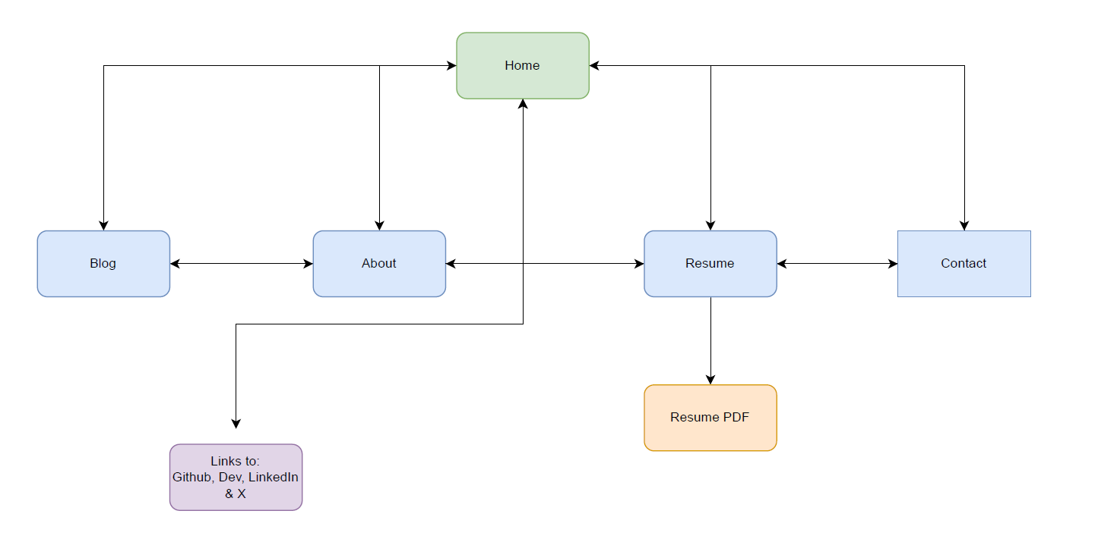
Sitemap

Slide 3

Web Page Design: Home Page

Slide 4
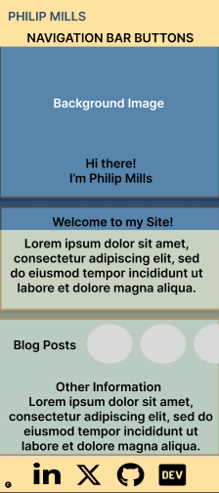
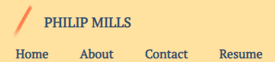
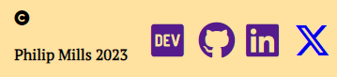
Wireframe – Mobile View
Header & Nav Bar
Footer

Slide 5
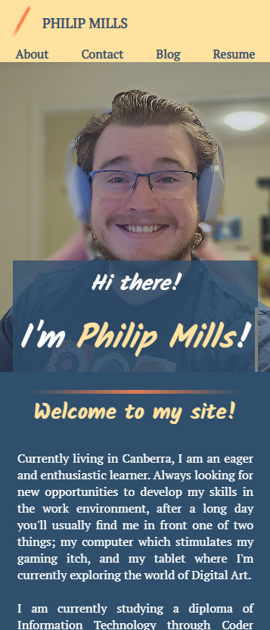
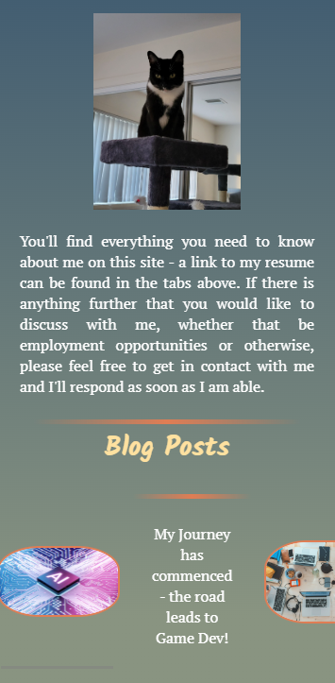
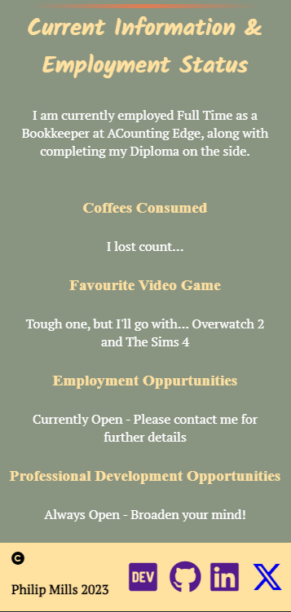
Mobile view - screenshots

Slide 6
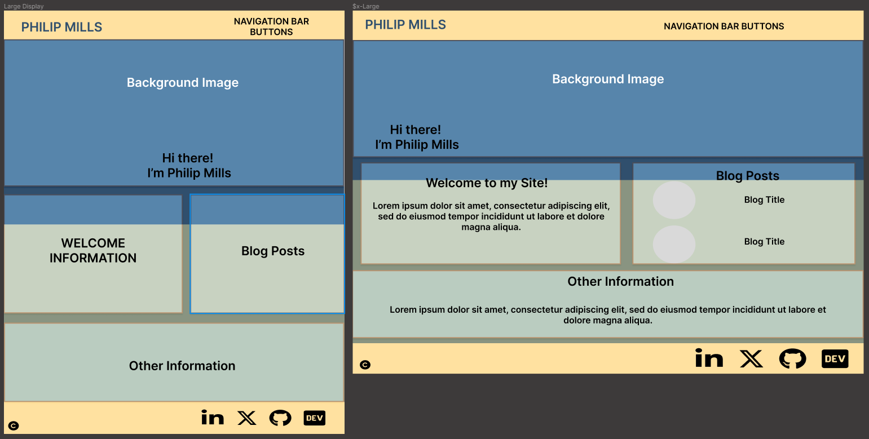
Wireframe – Medium - Desktop View

Slide 7
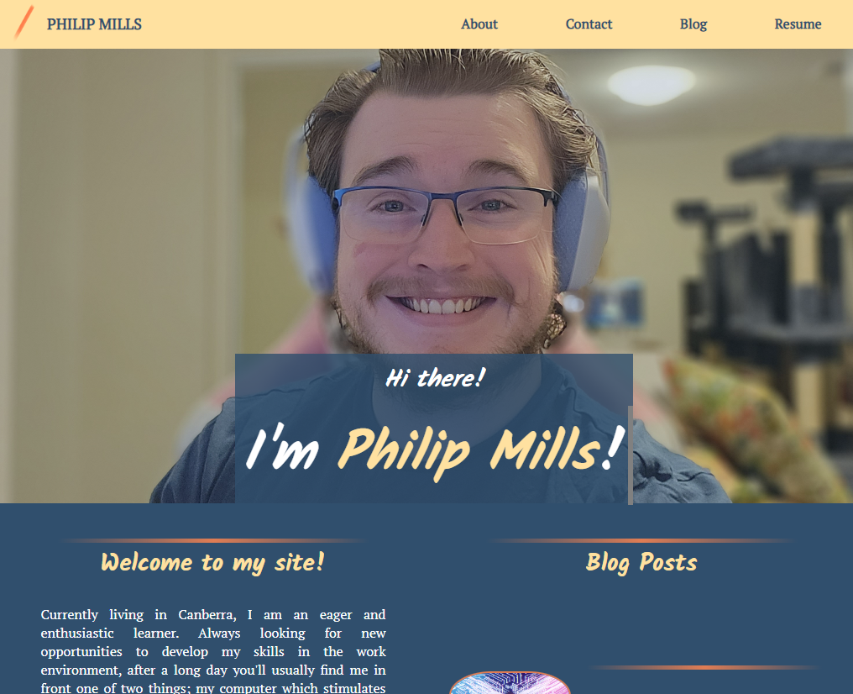
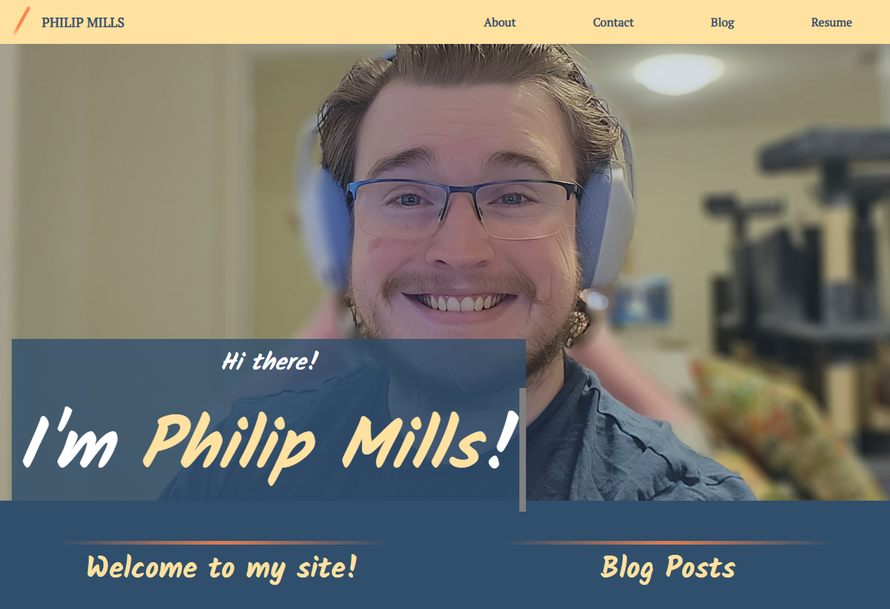
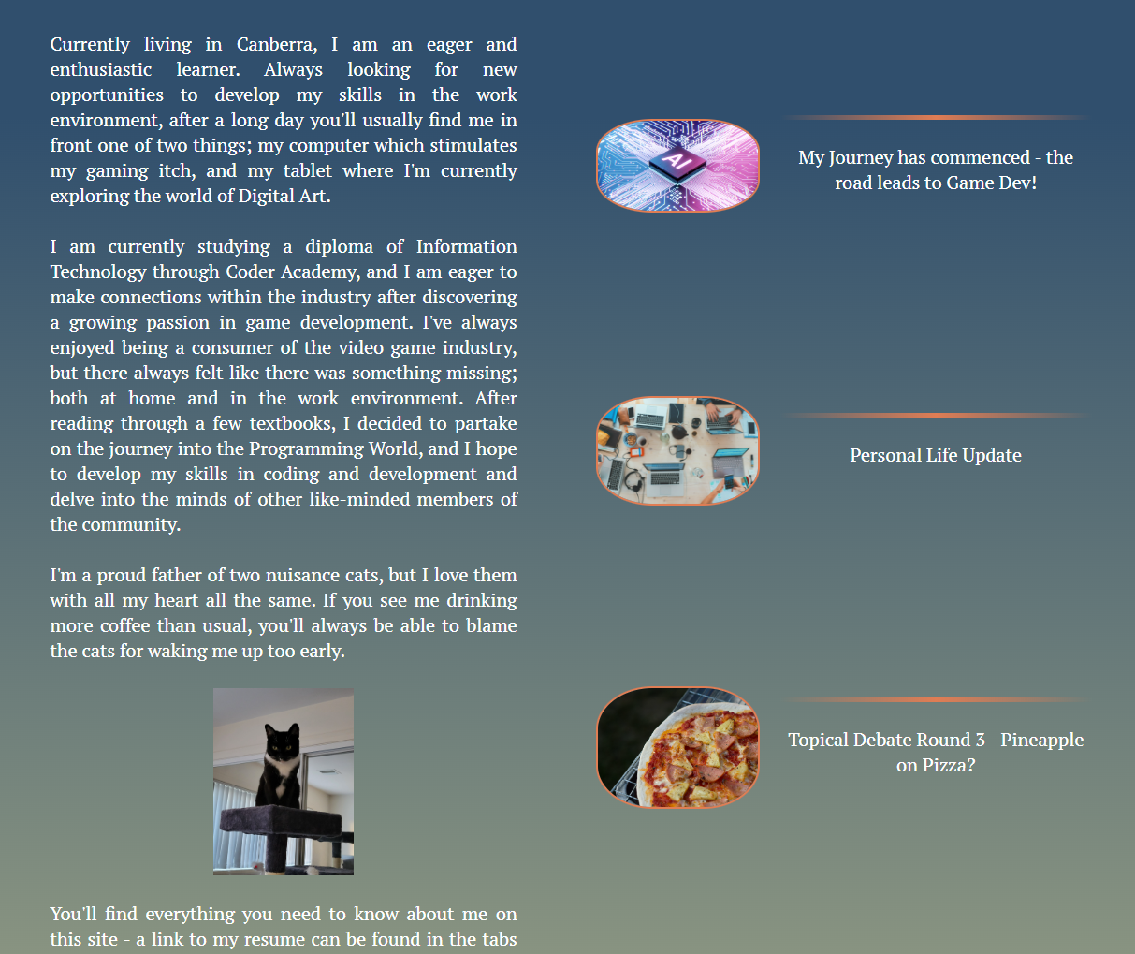
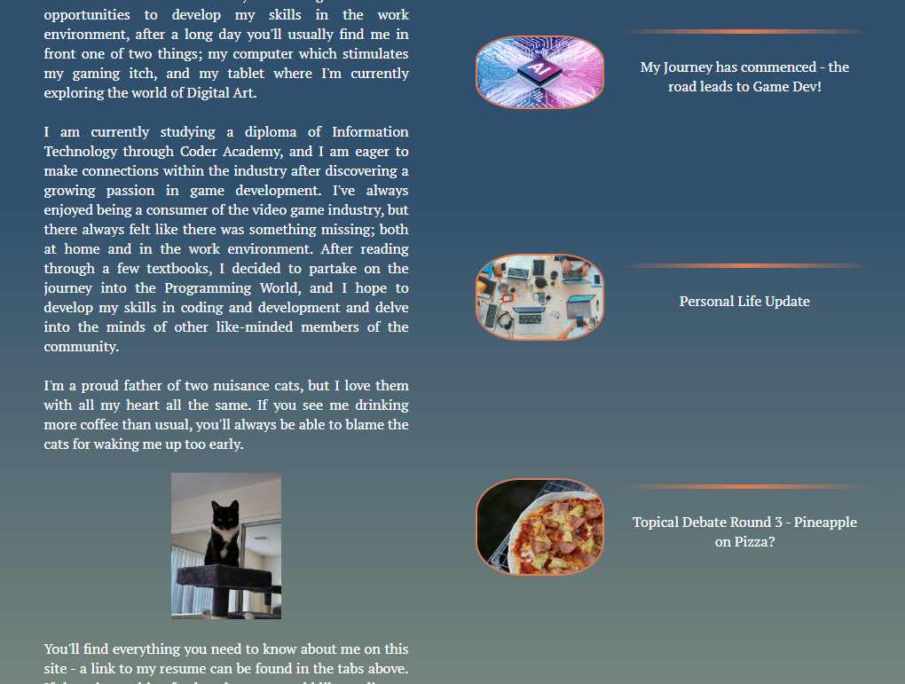
Larger screen and desktop view examples
Desktop
Large Screen

Slide 8
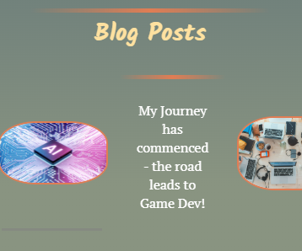

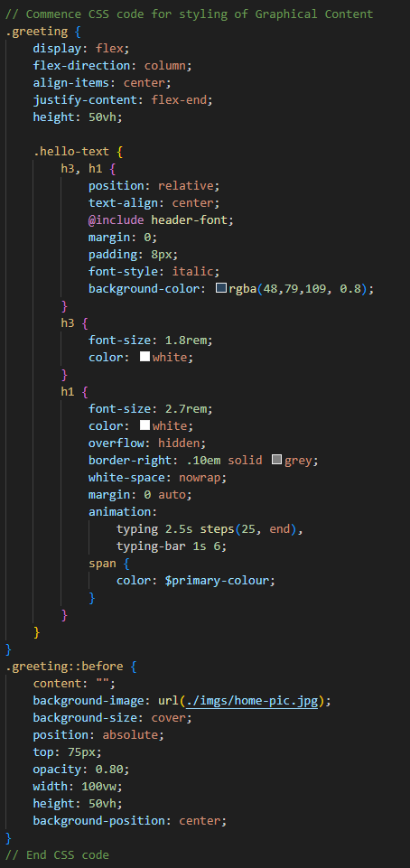
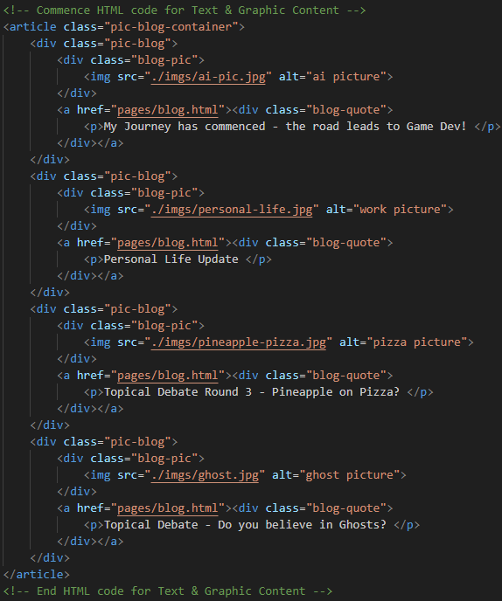
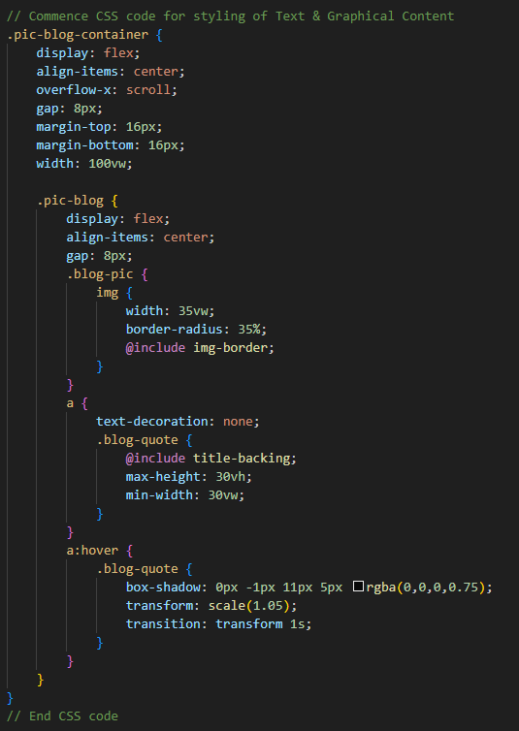
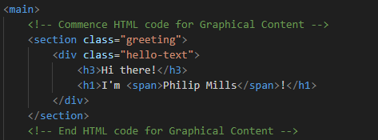
Home Page Graphical Features
SCSS Code Snippet
HTML Code Snippet
SCSS Code Snippet
HTML Code Snippet

Slide 9

Web Page Design: About Page

Slide 10
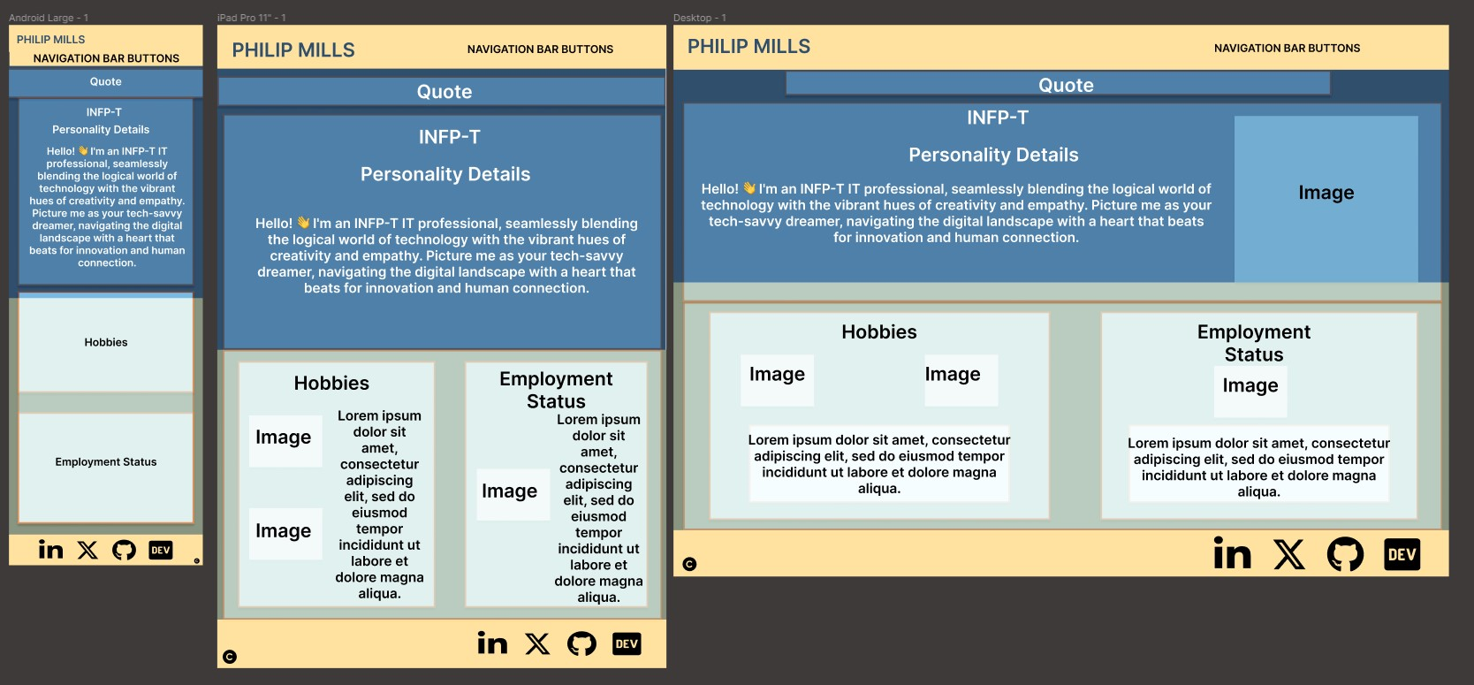
Wireframes

Slide 11
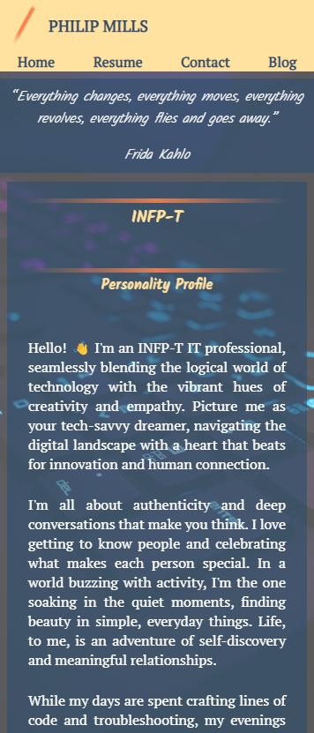
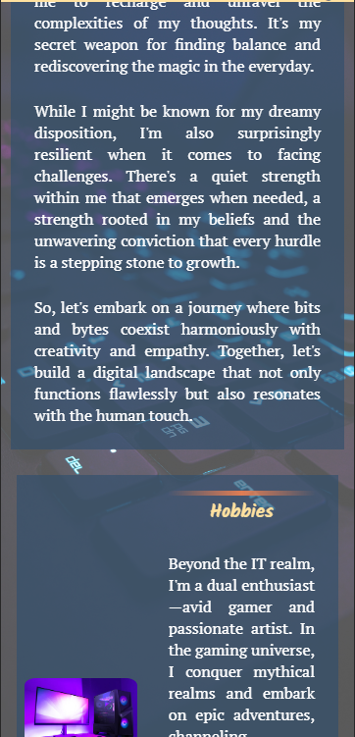
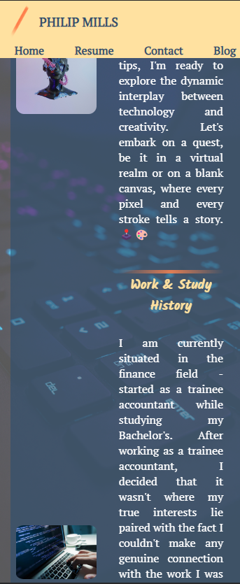
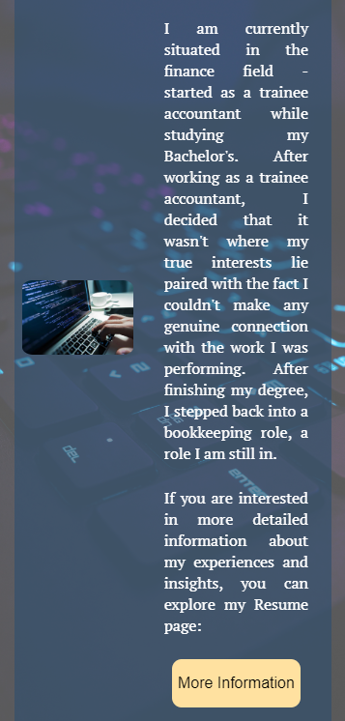
Mobile view - screenshots

Slide 12
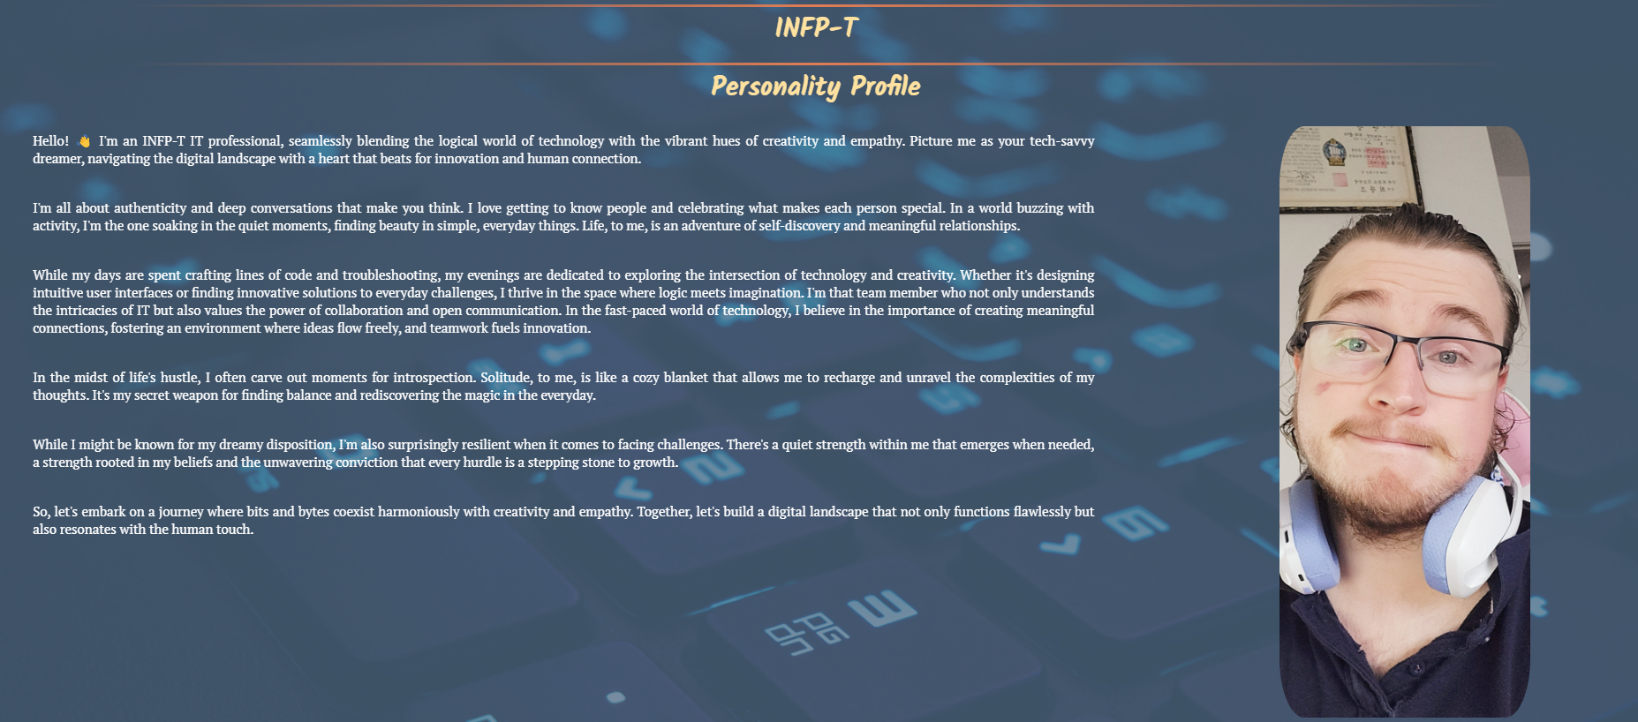

About Page Graphical Features
Background Image Opacity, utilising ::before pseudo element
Hidden Image in Personality Profile that only appears on desktop views
More Information button that acts as a link to the resume page

Slide 13
Web Page Design: Blog Page

Slide 14
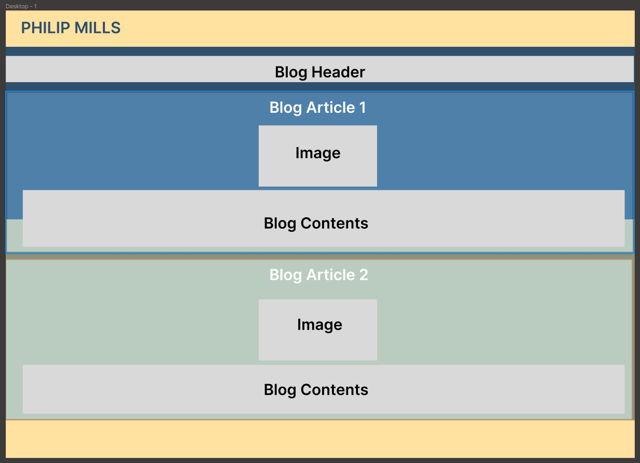
Wireframe

Slide 15
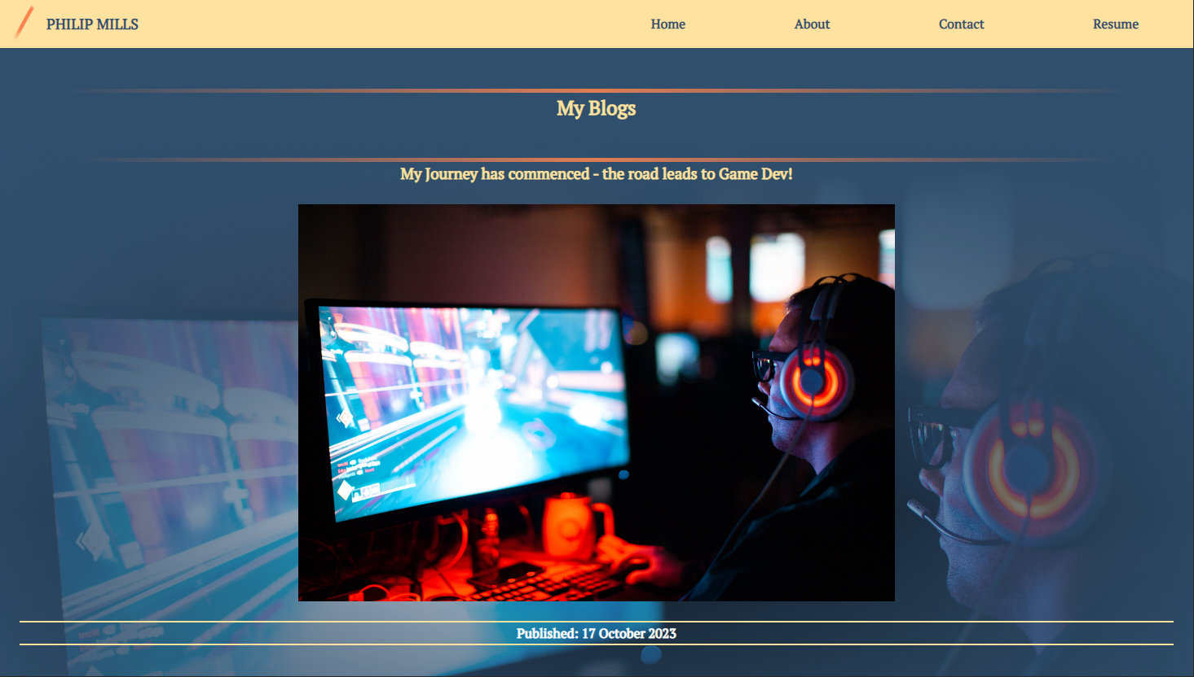
Desktop View

Slide 16



Graphical Content
Article elements used to create each divided blog post
::before pseudo element was then applied to each Article element to create the layered background image for each blog post

Slide 17
Web Page Design: Contact me

Slide 18
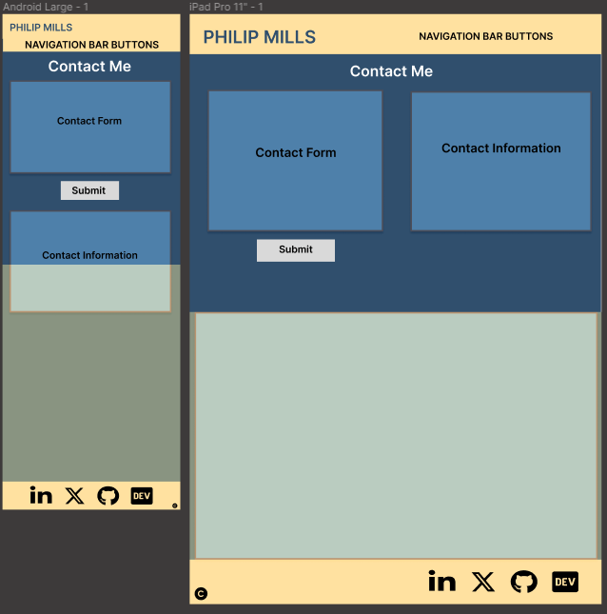
Wireframes

Slide 19
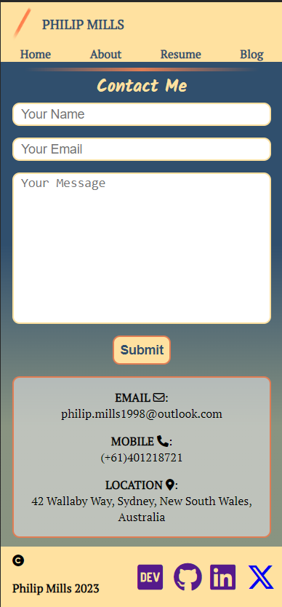
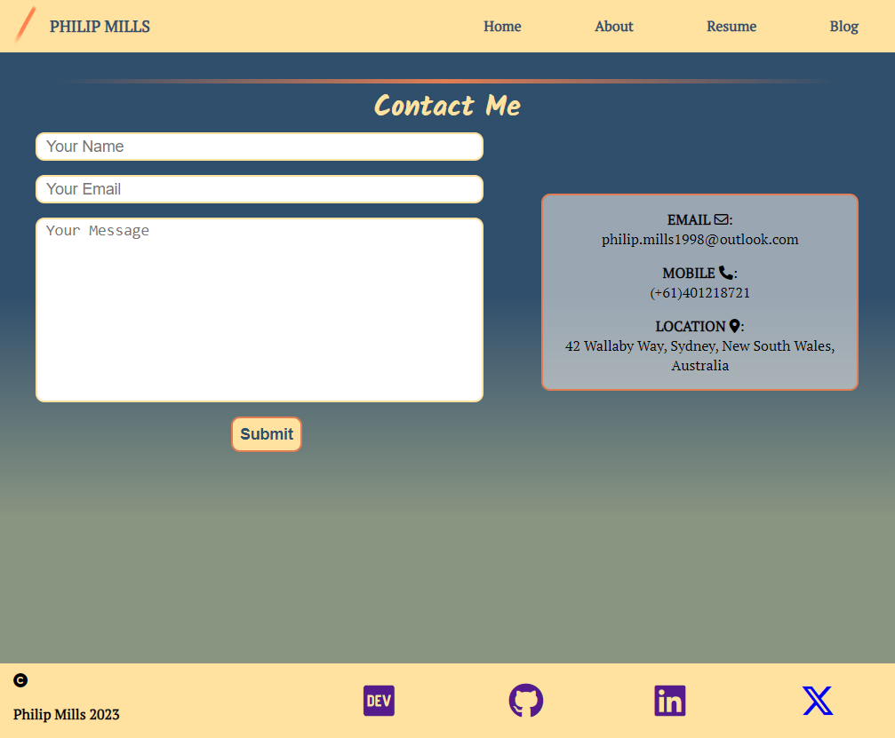
Contact page web view screenshots

Slide 20
Web Page Design: resume

Slide 21
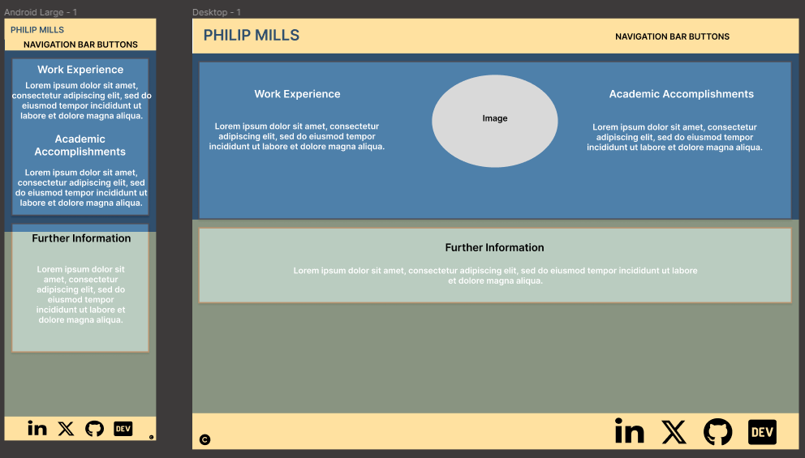
Wireframes

Slide 22
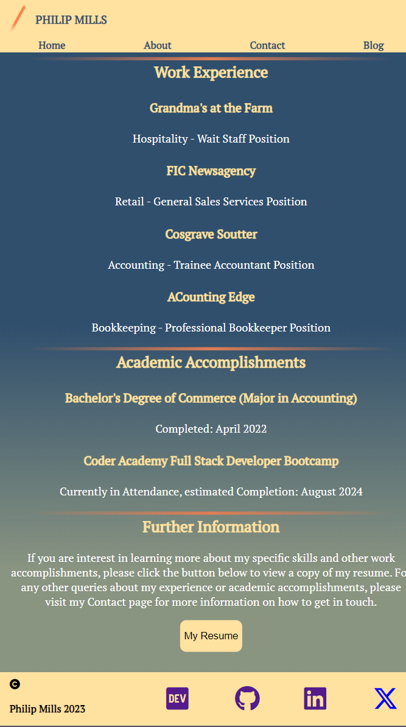
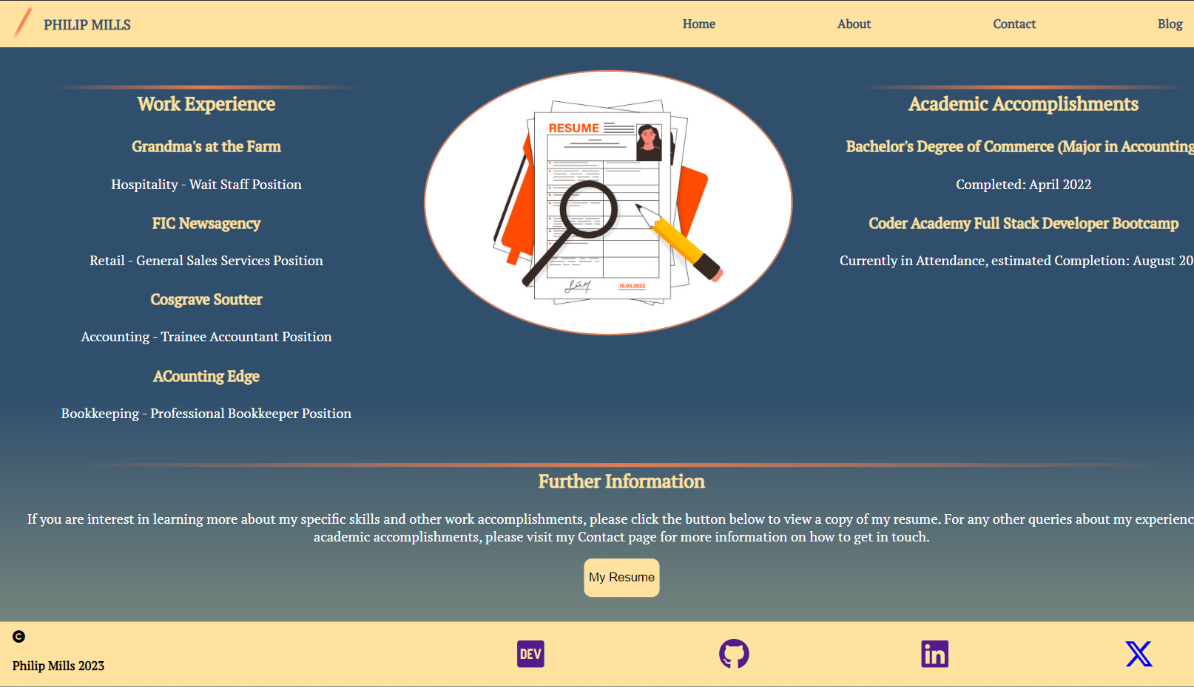
Contact Page Mobile and Desktop View
Two main divisions in layout – mobile/tablet and then to large/desktop view
Main difference is hidden vs unhidden image between the two views

Slide 23
Discussion
Difficulties and Roadblocks
Time management
Design process and changes in designs
Proper semantic HTML elements to be done as code is being prepared

